Slide 1

CapStore:An E-commerce Application github: https://github.com/KohliRamanpreet/capStore
By : Ramanpreet Kaur
46022644
Team 2
Mentor: Ganesh Prabu

Slide 2
Abstract
CapStore is an e-commerce application for managing online purchase and sale of products.
The main aim is to build end to end application using Spring boot as Framework used to build back end using java, Angular for building single page client application using html and typescript.
Web designing done using HTML , CSS , bootstrap
Rest Services used to handle request from client and render the resources.
The underlying protocol for REST is HTTP

Slide 3
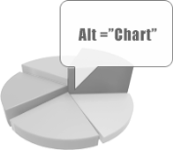
What is Ecommerce?
Ecommerce, also known as electronic commerce or internet commerce, refers to the buying and selling of goods or services using the internet, and the transfer of money and data to execute these transactions.
Ecommerce is often used to refer to the sale of physical products online.
Alt text examples for two different chart types on this slide:
1
Line chart showing proportion of shopping spent online
2
Column chart showing values of Global e-commerce market size from 2014-2023
2
1

Slide 4



Types of Users
Customer: Interested in using E-commerce for buying products.
Merchant: Interested in using E-commerce for selling products.
Admin: One who handles the entire E-commerce application.
1
Customer
1
2
Merchant
3
Admin
2
3

Slide 5
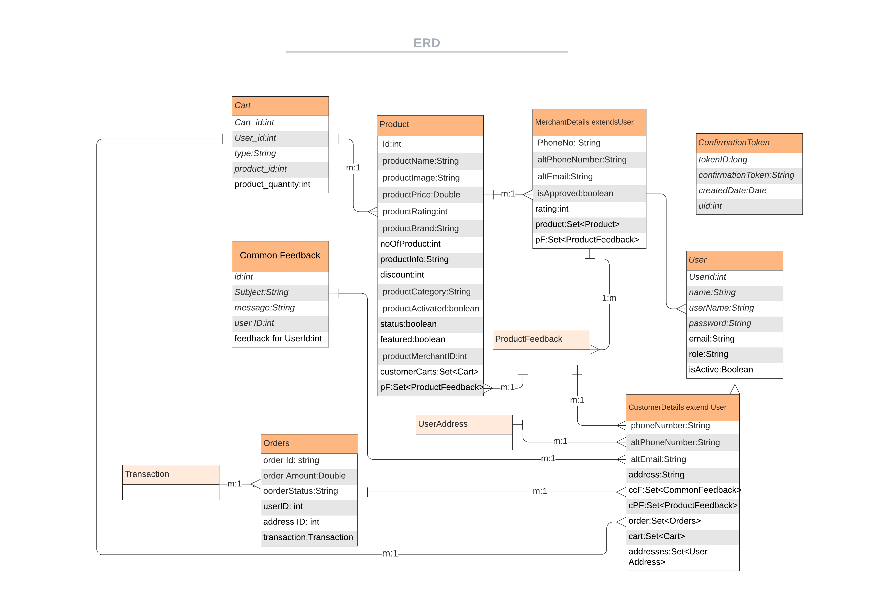
ER diagram

Slide 6
Block diagram
Answer
Rest Client
Controller
ok!
Service
Repository
Http calls
Answer
Exception handler
Throws
custom
exception
Entity
SPRING APPLICATION

Slide 7

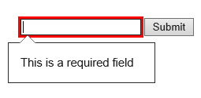
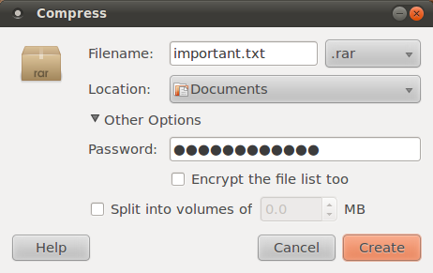

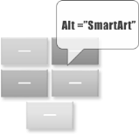
Modules covered:
Sign up and Activation: Sign up/registration for non-existing customer.
Form Validation is done using template driven form in angular
Customer Validation during sign in is done through Email.
LogIN/LogOut/Session: Customer will be able to log in, session will be maintained and log out.
PasswordEncryption : for security purpose, then encrypted password is stored into the database
Change Password: Customer can change password
Forget Password: an email containing the decrypted customer’s password is sent
Homepage is designed with rotes to its internal component

Slide 8
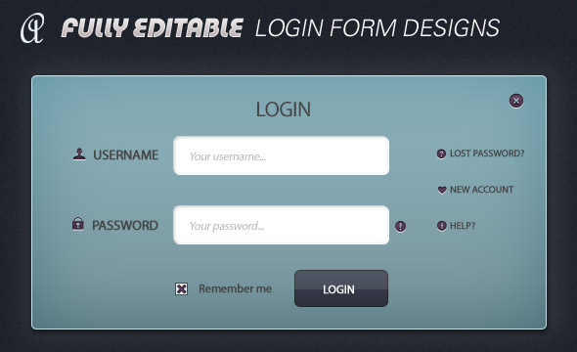



Security
The basic security covered in this module is:
The inner components i.e. Homepage , product page cannot be accessed without logging in which is done using Auth Guard
The password is stored in encrypted format inside the database
The customer should be a valid one, which is confirmed through email.
Strong password Formation is ensured

Slide 9


Annotation used in Spring boot
1
@SpringBootApplication
@EntityScan
@EnableJpaRepositories
@Controller
@Entity
@RestController
@RequestMapping
2
@CrossOrigin
@Autowired
@ExceptionHandler
@Service
@Repository
@GetMapping
@PostMapping

Slide 10


JPA Annotation used More About designing:
@Entity
@Id
@Table
@Column
@OneToMany
@GeneratedValue
@Temporal
@MappedSuperclass
Effective use of bootstrap classes has been done
.carousel
. .carousel-indicators
.carousel-inner
.col-*-*
.carousel-control
.navbar navbar-inverse
.dropdown
.form-control
. glyphicon
.hidden
.jumbotron
.item
.text-danger
.footer
. radio-inline
And many more

Slide 11
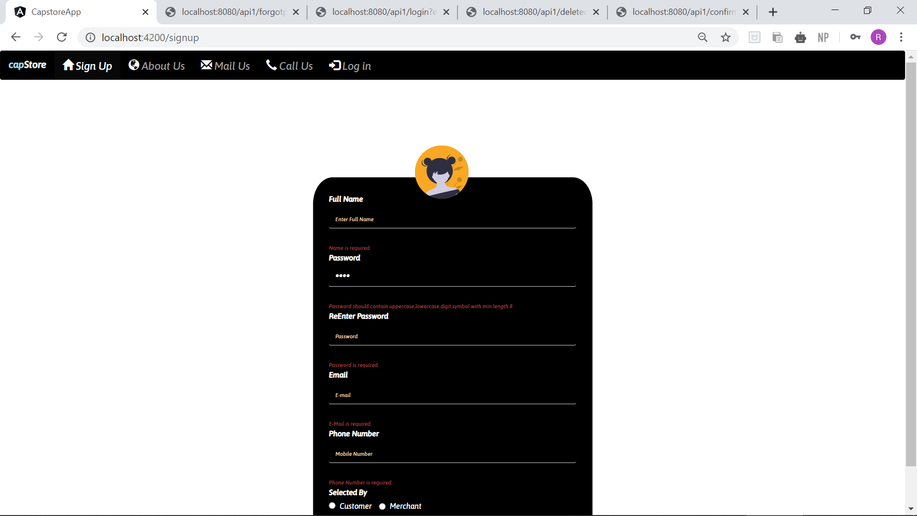
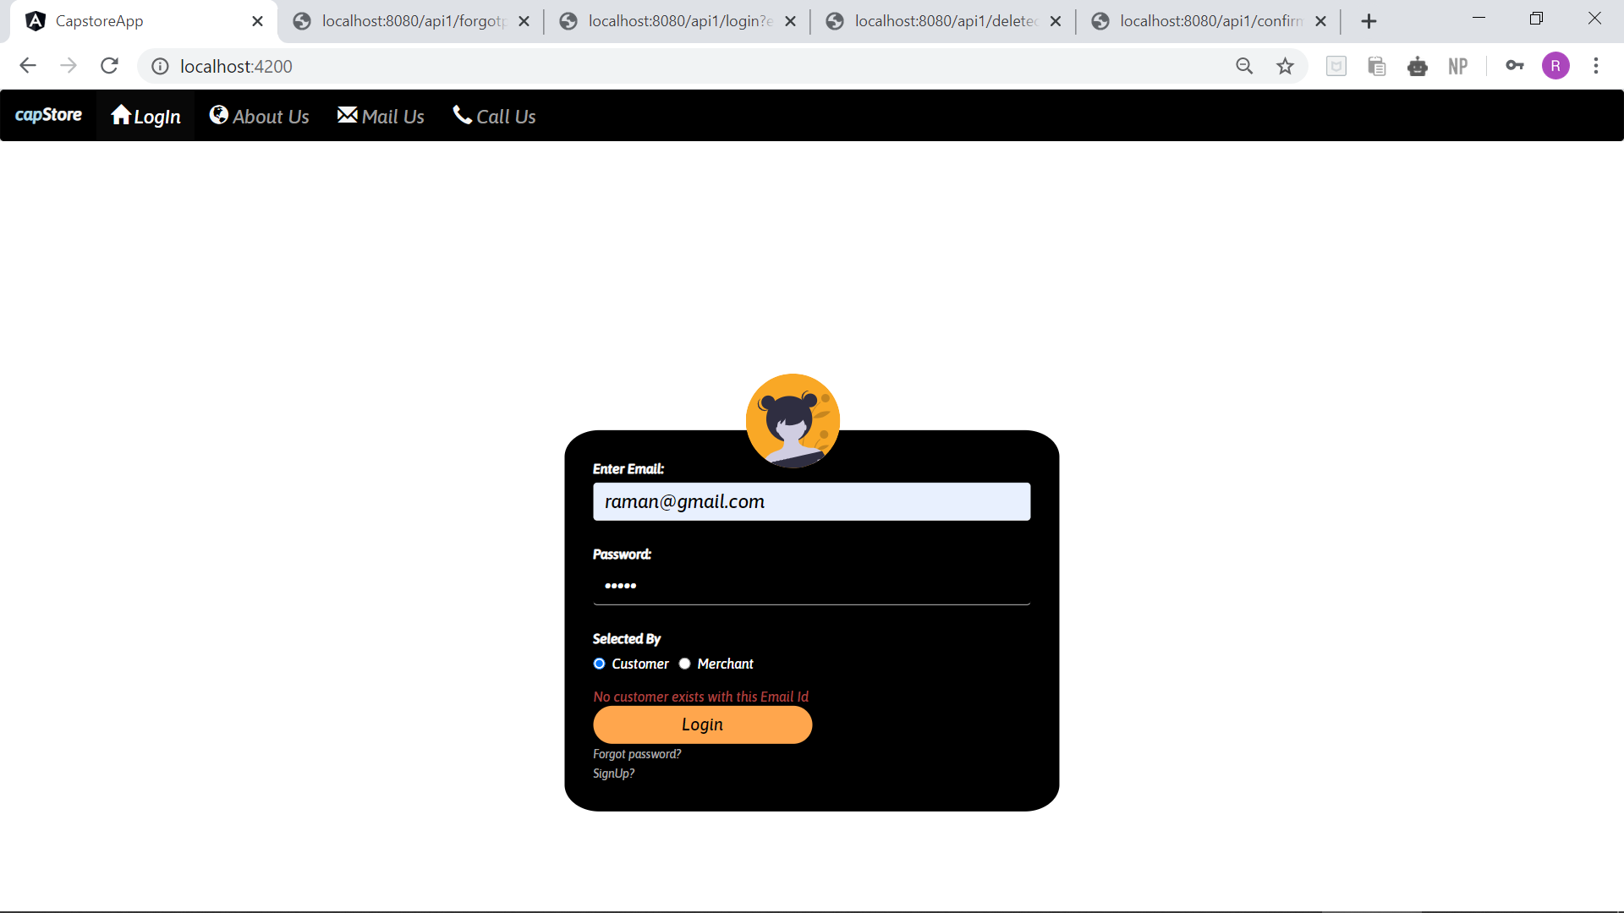
More on validation:

Slide 12

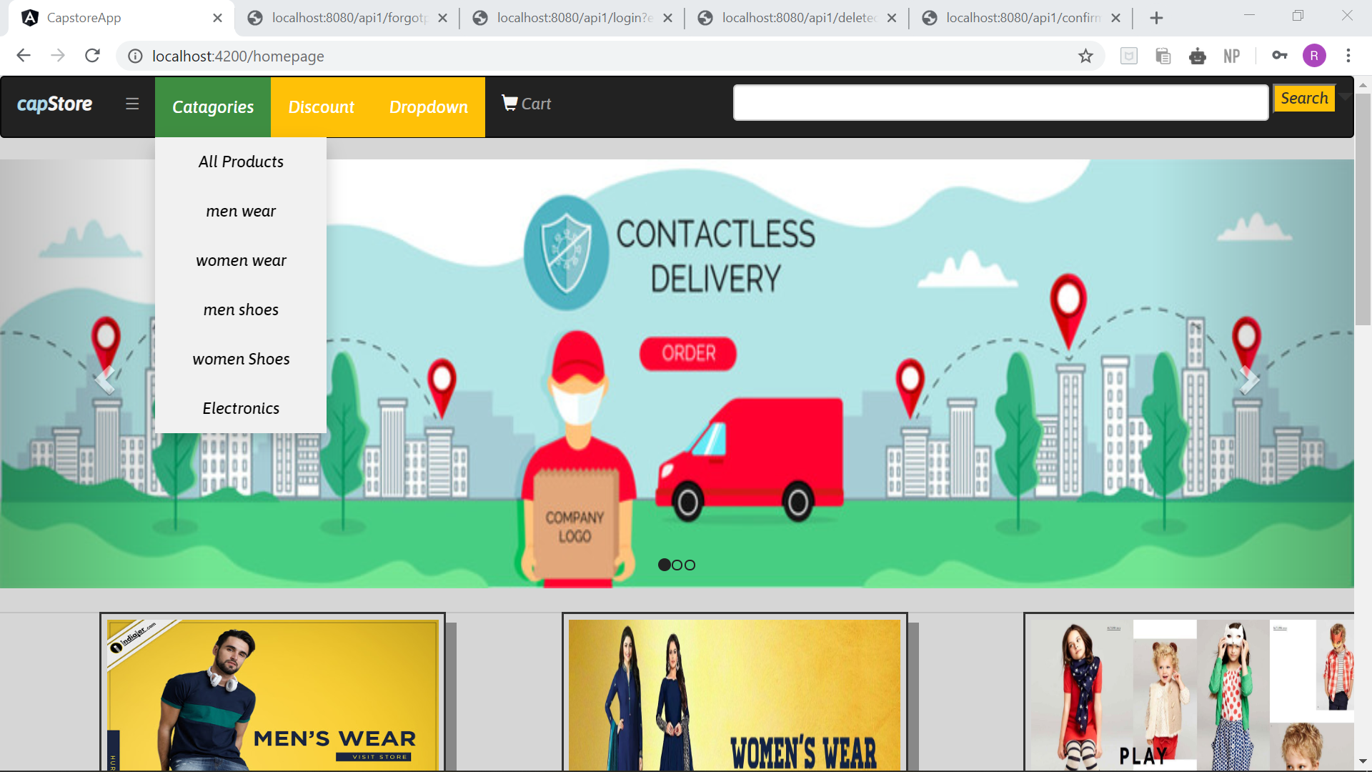
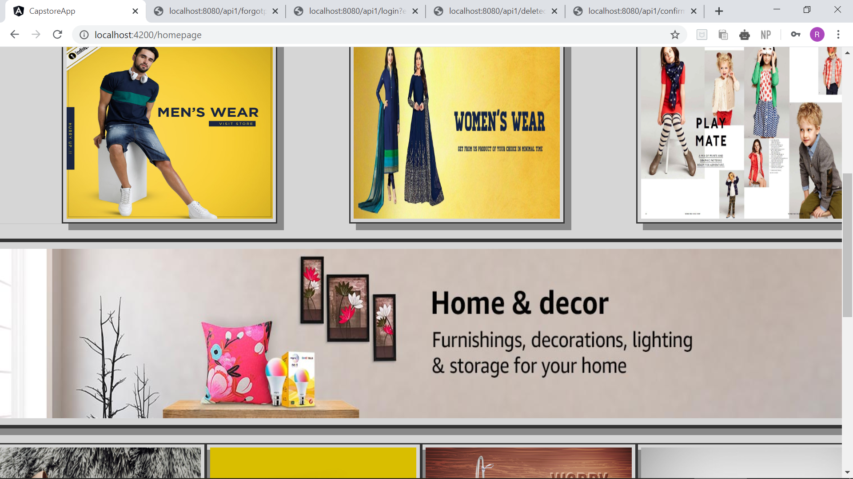
Screenshots

Slide 13

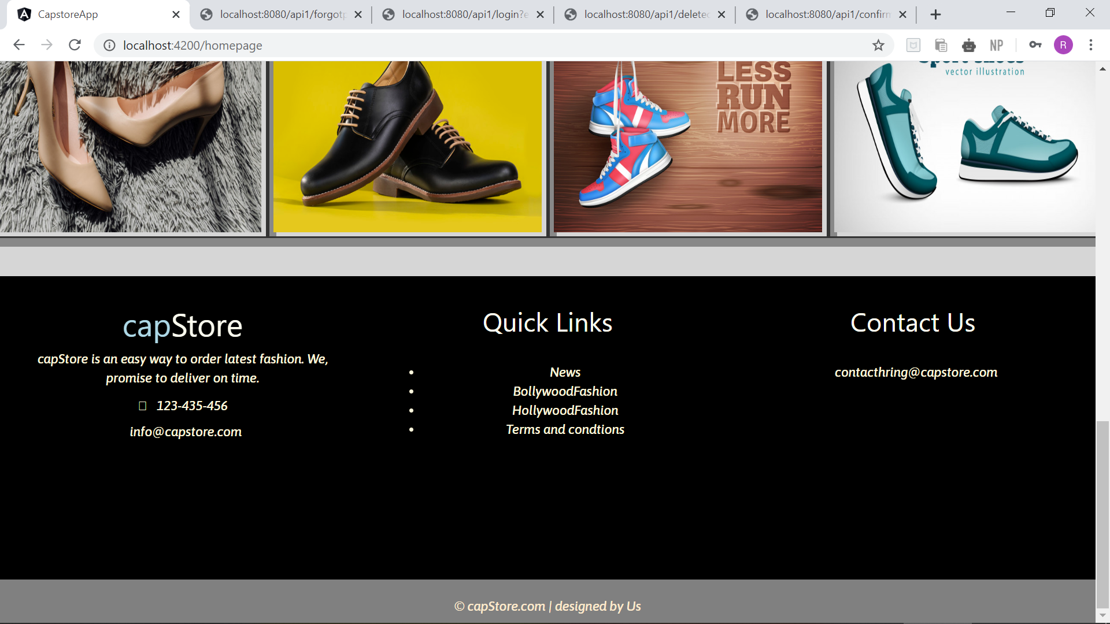
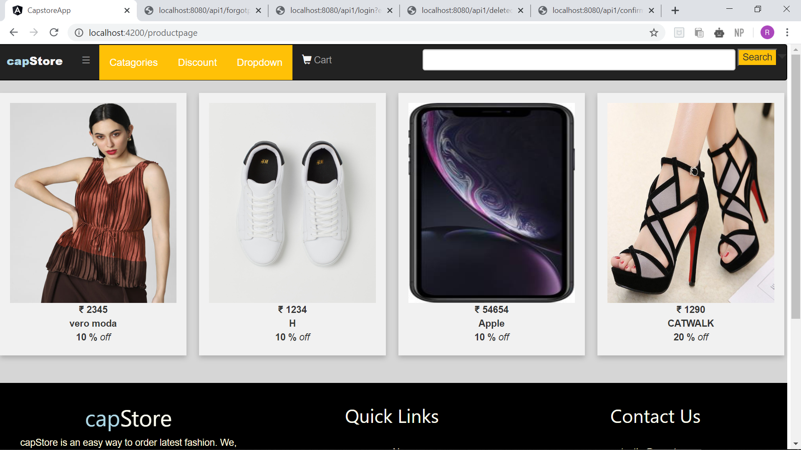

Slide 14

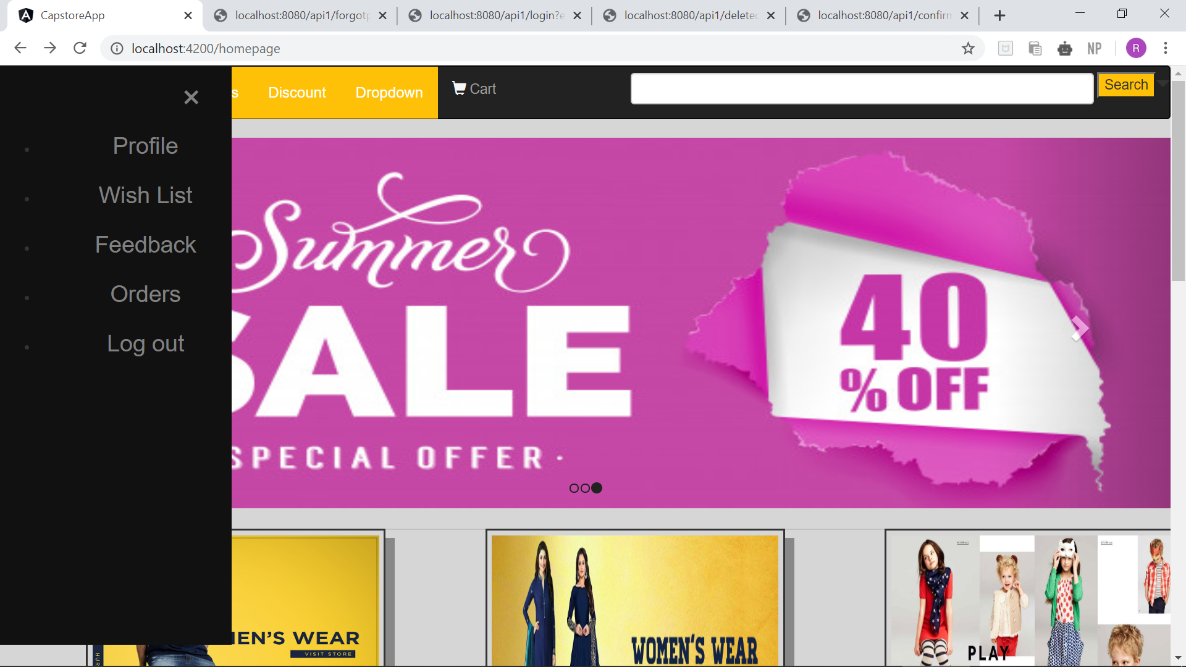

Slide 15

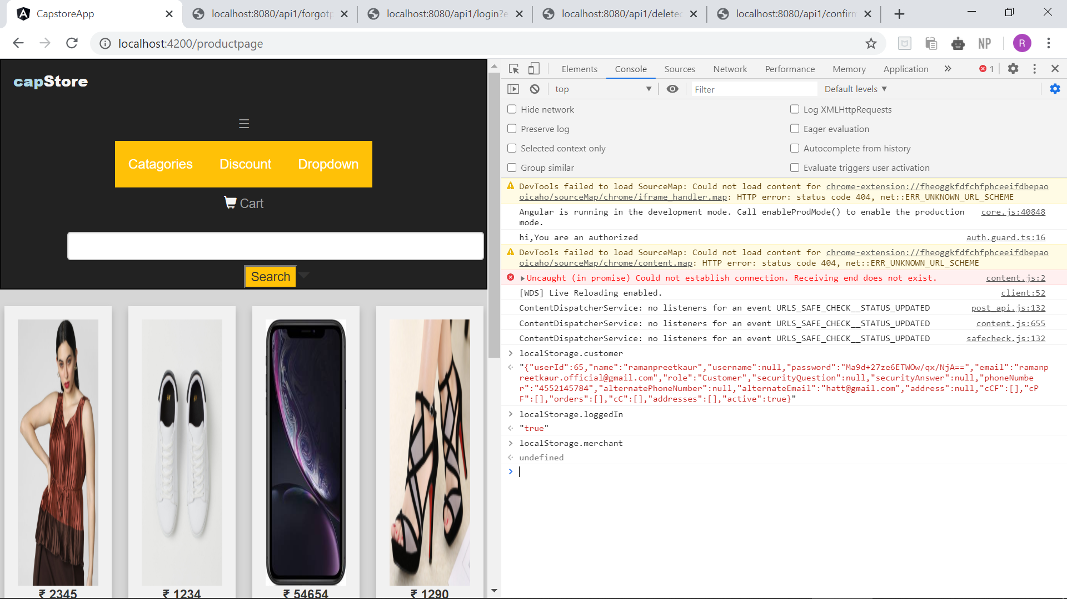
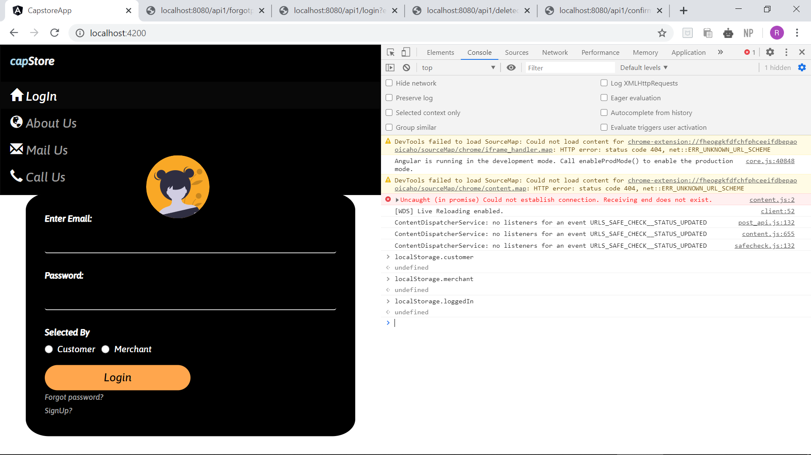
More on sessions in angular

Slide 16


